Slide 1
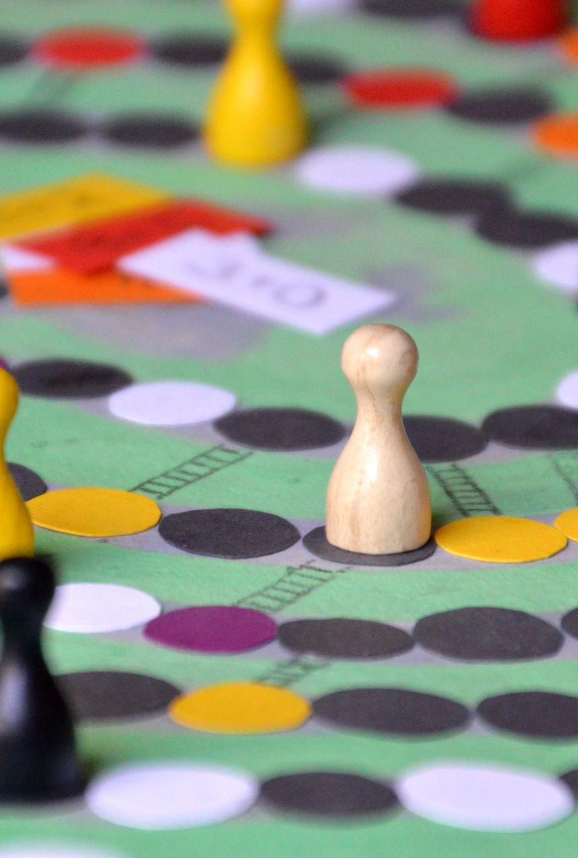
SECTION 1 The Single-Person Decision Problem
Decision Theory
Game Theory
Descriptive
(Real)
Empirical/
Experiments
Normative
(Rational)
Math Models
Topic 1
Rational Choice Paradigm
Module 1
Actions
Outcomes
Preferences
Class 4

Slide 2
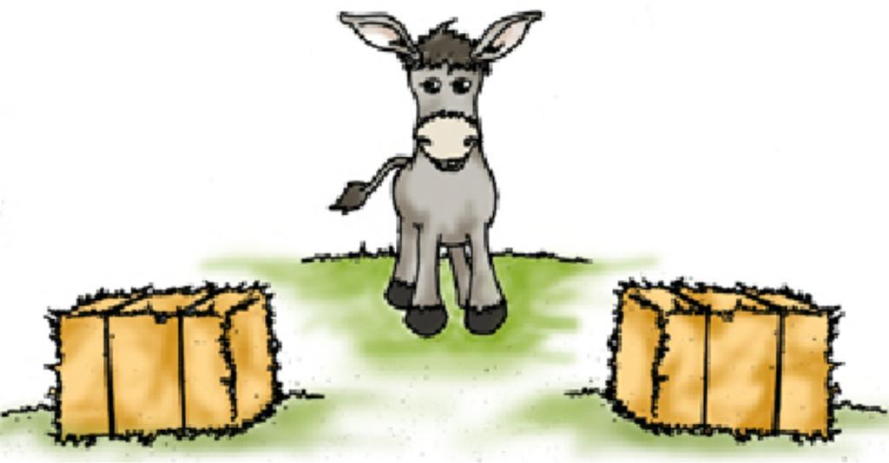





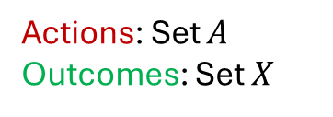



Rational Preference Relations
Actions: Set $A$
Outcomes: Set $X$
$$≻$$
Complete
$$≻$$
$$≻$$
…pairwise comparison of outcomes
Transitive
At least one best outcome…
…finding the action(s) corresponding to…
At least one worst outcome…
$$≻$$
Strict Preference
$$∼$$
Solving the single-person decision problem
Indifference
…doesn’t imply indecision
Existence of the payoff function
‘I don’t care’
‘I can’t choose’
REVIEW

Slide 3

MODULE 2 The Payoff Function
ACTIONS
OUTCOMES
PREFERENCES
Pair-wise comparisons
A more operational/quantitative alternative to preference relations
Global ranking of outcomes
A function that assigns numerical values to outcomes
Higher values assigned to more preferred outcomes
Ordinal construct: Order of preference, not intensity
Different decision-makers have different payoff functions for the same outcomes.
Proposition: A payoff function exists if the set of outcomes is finite, and preference relations are rational.
REVIEW

Slide 4



The Single-Person Decision Problem
Actions
Outcomes
Payoff Function
Preferences
Formal structure = coherent framework for analysis

Slide 5
The Payoff Function: Ranking Actions
…bypass…
Actions
Outcomes
Payoff Function
action
Preferences are over outcomes
But…choices must be made over actions
The decision-maker prefers one outcome over another.

Slide 6

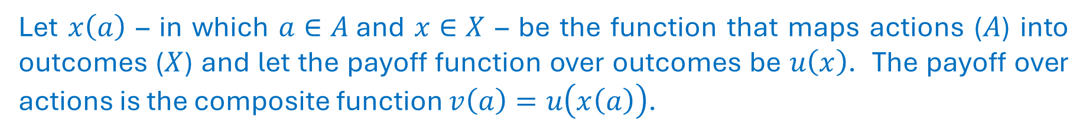
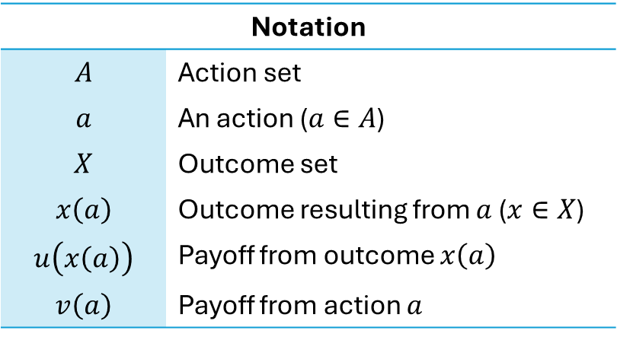
The Payoff Function: Ranking Actions
Inner function: maps each action to an outcome
Let $x\left(a\right)$ – in which $a∈A$and $x∈X$ – be the function that maps actions ($A$) into outcomes ($X$) and let the payoff function over outcomes be $u\left(x\right)$. The payoff over actions is the composite function $v\left(a\right)=u\left(x\left(a\right)\right)$.
Outer function: assigns a numerical value to each outcome
Notation
$$A$$ | Action set
$$a$$ | An action ($a∈A$)
$$X$$ | Outcome set
$$x\left(a\right)$$ | Outcome resulting from $a$ ($x∈X$)
$$u\left(x\left(a\right)\right)$$ | Payoff from outcome $x\left(a\right)$
$$v\left(a\right)$$ | Payoff from action $a$
…ordinal construct

Slide 7
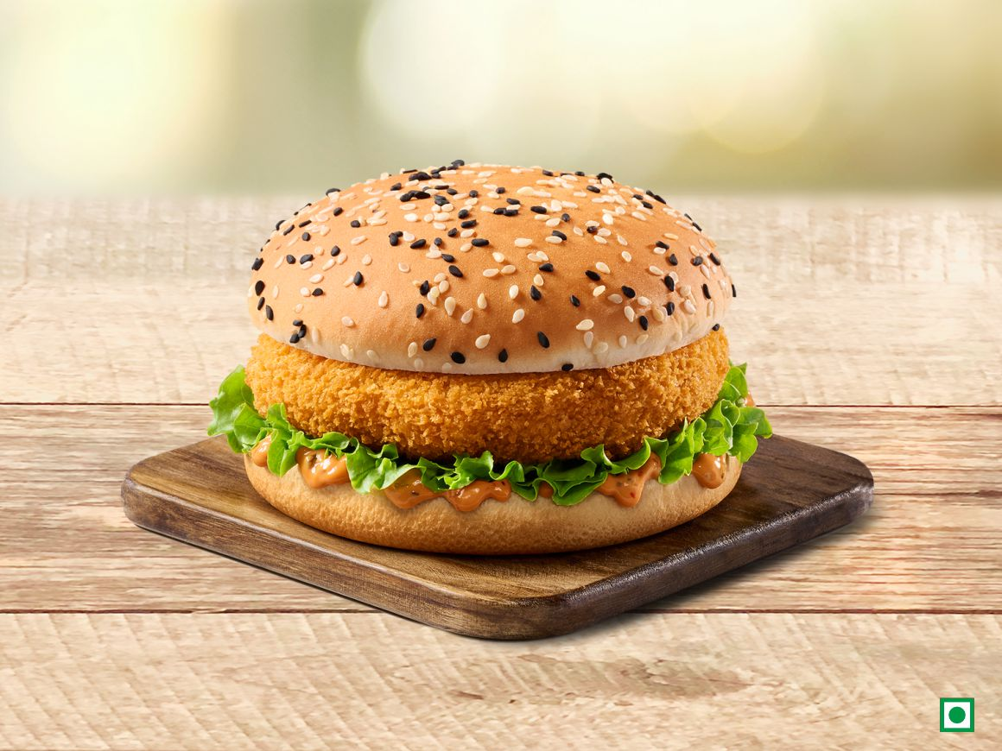
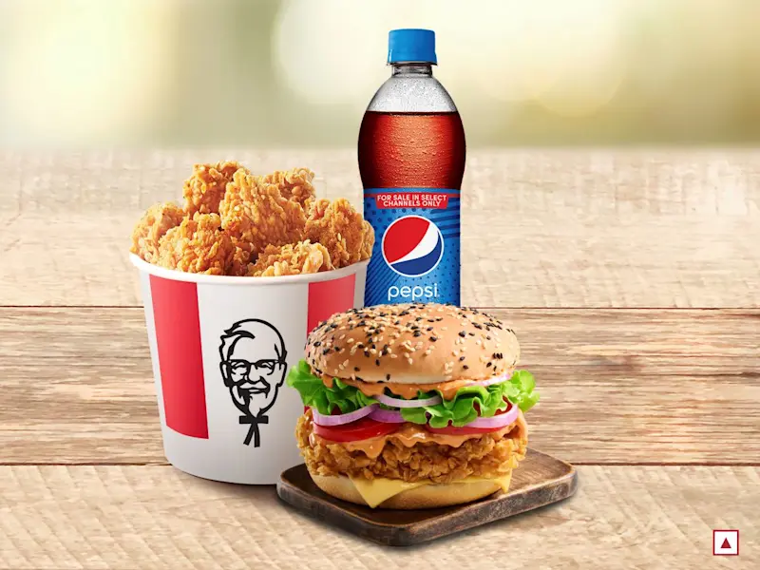
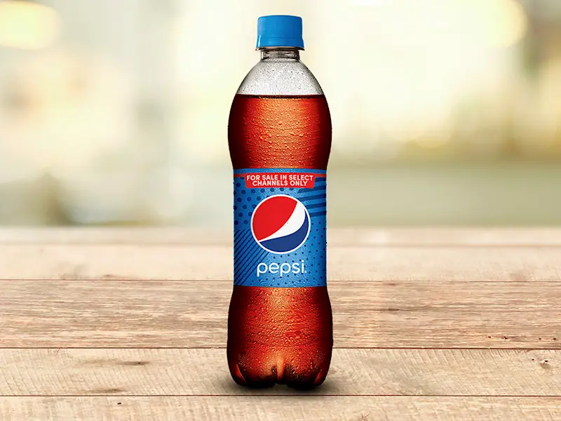
A Decision Problem: Ordering Food
BURGER
₹220
BURGER & COKE
₹480
MEAL
₹440
Price
Quantity

Slide 8
Logistics Exams and Grading Scheme
Exam 2
April
24
Friday
2:30 – 4 PM
Focus
Problem-solving
Exam 1
February
27
Friday
2:30 – 4 PM
35%
2 In-Class Quizzes Per Week
Quizzes = 10% of final grade
25%
Quiz Scope: Current Class + One Previous Class
Hard copy submissions
Test 1
February
3
Tuesday
4 – 5:30 PM
Test 2
March
27
Friday
2:30 – 4 PM
Focus
Conceptual understanding
Attendance
Quizzes
15%
15%
10%

Slide 9

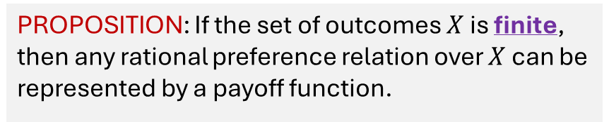
MODULE 3 Action Spaces
SECTION 1
The Single-Person Decision Problem
TOPIC 1
The Rational Choice Paradigm
MODULE 1: Actions, Outcomes, & Preferences
MODULE 2: The Payoff Function
Discrete versus Continuous
PROPOSITION: If the set of outcomes $X$ is finite, then any rational preference relation over $X$ can be represented by a payoff function.

Slide 10



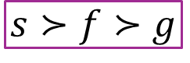

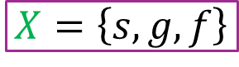
Actions, Outcomes, & Preferences
REVIEW
Decision Problem: How to spend a Friday evening?
Study for Exam
Play Games
Socialize with Friends
Actions
Better Prepared for Exam
Immediate Relaxation
Build Relationships
Outcomes
$$A=\left\{S, G, F\right\}$$
$$X=\left\{s, g, f\right\}$$
$$s≻f≻g$$
Set of Actions
Set of Outcomes
Preference Relations

Slide 11

Discrete Action Spaces
$$A=\left\{S, G, F\right\}$$
Set of Actions
Each element of the action set is a discrete action
Finite number of actions to choose from
Finite number of outcomes

Slide 12

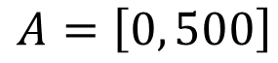
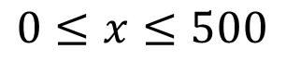
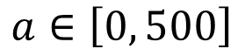
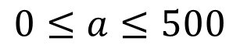
Continuous Action Spaces
Decision problem: How much juice should I drink?
$$A=\left[0, 500\right]$$
500 mL
Finite range…continuous
Infinitely many actions to choose from
Infinitely many outcomes
Actions
Notation
$$a∈\left[0, 500\right]$$
$$0≤a≤500$$
‘belongs to’
‘is an element of the set’
Outcomes
$$0≤x≤500$$

Slide 13


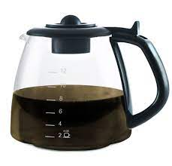


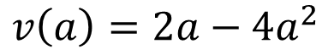
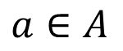
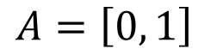
Optimal Coffee Consumption
A single-person decision problem
Action Space
Preferences
$$A=\left[0, 1\right]$$
Too little = Sleepy
Action: How much coffee I choose to drink
$$a∈A$$
1 Liter
Continuous
Payoff Function
Preferences
Complete
Transitive
Too much = Sick
$$v\left(a\right)=2a−4a^{2}$$
…ranking infinitely many actions

Slide 14
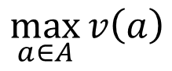
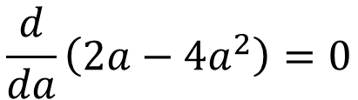
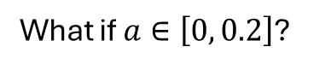
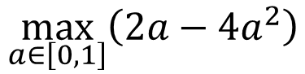
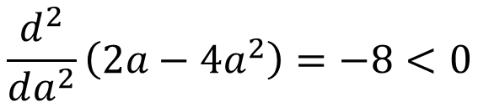
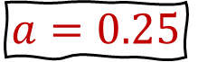
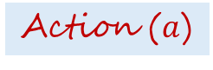
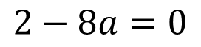
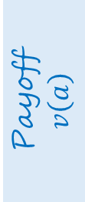
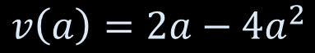
SOLVING THE DECISION PROBLEM The First-Order Condition
The Maximization Problem
$$\max_{a∈A}{v\left(a\right)}$$
What if $a∈\left[0, 0.2\right]$?
$$\max_{a∈\left[0, 1\right]}\left(2a−4a^{2}\right)$$
Payoff
$$v\left(a\right)$$
Payoff Function
$$\frac{d}{da}\left(2a−4a^{2}\right)=0$$
$$v\left(a\right)=2a−4a^{2}$$
$$2−8a=0$$
$$a=0.25$$
$$\frac{d^{2}}{da^{2}}\left(2a−4a^{2}\right)=−8<0$$
Action ($a$)

Slide 15

MODULE 4 Decision Trees
DECISION-MAKER
ACTIONS
OUTCOMES
PAYOFF
Modeling tool
…graphical
…intuitive
Decisions involving time & uncertainty
An Alternative Approach to Modeling Decision Problems
…revisited in dynamic games

Slide 16




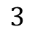



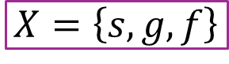
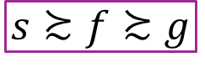

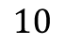
A Decision Tree
Nodes
Branches
$$A=\left\{S, G, F\right\}$$
Action
$$10$$
Set of Actions
$$S$$
Root node
$$L$$
Decision node
$$G$$
$$X=\left\{s, g, f\right\}$$
Decision-maker
$$7$$
Payoff
$$M$$
Set of Outcomes
$$F$$
Decision node
$$3$$
$$s≿f≿g$$
Preference Relations
Left to right
Terminal node
(Outcome)

Slide 17

MODULE 5 A Rational Player
An Important Assumption…
Modeling the decision-maker
Assumptions

Slide 18



Homo economicus
External
: Actions, Outcomes
All-knowing
Internal
: Preferences
Selfish
PREDICTABLE
The Theory of Rational Choice (Rational Choice Paradigm)
Model for decision-makers: Applies to individuals, corporations, committees, nation-states, etc.
Rationality: The decision-maker chooses actions that maximize his well-being based on his payoff function.
In any situation, chooses an action that’s at least as good as every other available action based on preferences
…the ‘economic man’
…the ‘ideal’ human
…not absolute
…the ultimate decision-maker

Slide 19
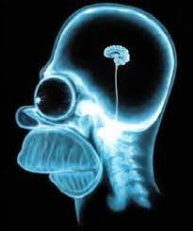


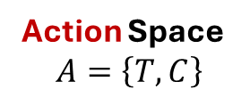
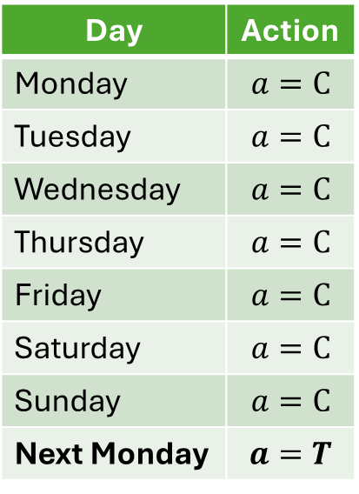
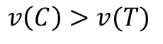
Homo erraticus
Discrete
Action Space
$$A=\left\{T, C\right\}$$
Next week
$$A=\left\{T, C, J\right\}$$
Behavior = Preferences
Construct a payoff function
Day | Action
Monday | $$a=C$$
Tuesday | $$a=C$$
Wednesday | $$a=C$$
Thursday | $$a=C$$
Friday | $$a=C$$
Saturday | $$a=C$$
Sunday | $$a=C$$
Next Monday | $$a=T$$
$$v\left(C\right)=10$$
$$v\left(T\right)=0$$
$$v\left(C\right)>v(T)$$
…discrete
consistent
…rational choices
…the ‘irrational man’
…not fictitious
…inconsistent with the theory of rational choice

Slide 20



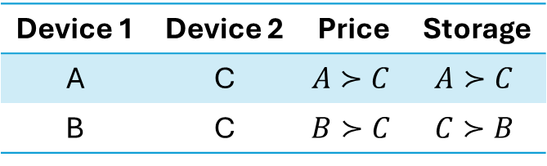
COGNITIVE BIASES The Decoy Effect
…mental shortcuts that can lead to errors in decision-making.
Storage
Price
…something fake used to divert attention from the real target
Lower price
Asymmetrically dominated
Greater storage
The company doesn’t intend to sell C
Device | A | B | C
Price (Rs.) | 40000 | 30000 | 45000
Storage (GB) | 300 | 200 | 250
Device 1 | Device 2 | Price | Storage
A | C | $$A≻C$$ | $$A≻C$$
B | C | $$B≻C$$ | $$C≻B$$
Decoy
A fully dominates C. B partially dominates C.
The presence of C makes A look superior to B.
As a result, some people who would have chosen B switch to A.
Goal: Push Device A
Q: Introduce a new device D instead of C with the goal of pushing device B. What would you set the price of D and what would be its storage?
Introducing a third, less appealing option (the decoy) can shift preferences between two original options.

Slide 21
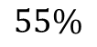
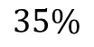
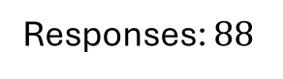
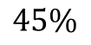
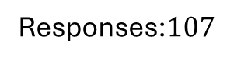
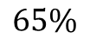
A Decision Problem: Ordering Food
DECOY
BURGER
₹220
BURGER & COKE
₹480
MEAL
₹440
Responses: $88$
$$55\%$$
$$45\%$$
Price
Quantity
Responses:$107$
$$35\%$$
$$65\%$$

Slide 22


COGNITIVE BIASES The Anchoring Effect
…where else?
Decisions are heavily influenced by the first piece of information (the anchor).
The anchor
₹ 2500
₹ 1500
₹ 500
A real estate agent shows you an overpriced house first; subsequent options seem cheaper and more appealing.

Slide 23


Logistics Exams and Grading Scheme
…The Anchoring Effect
Exam 2
April
24
Friday
2:30 – 4 PM
Focus
Problem-solving
Exam 1
February
27
Friday
2:30 – 4 PM
35%
2 In-Class Quizzes Per Week
The anchor
25%
Reeeelief
1 Take-Home Assignment Per Week
Test 1
February
3
Tuesday
4 – 5:30 PM
Test 2
March
27
Friday
2:30 – 4 PM
Focus
Conceptual understanding
Quizzes
Attendance
15%
15%
10%

Slide 24
COGNITIVE BIASES The Framing Effect
Choices depend on how options are presented.
90% Fat Free
Contains 10% Fat

Slide 25
More Cognitive Biases…
Endowment Effect
Scarcity Effect
Social Proof
Hyperbolic Discounting
Exclusive Access
Loss Aversion

Slide 26
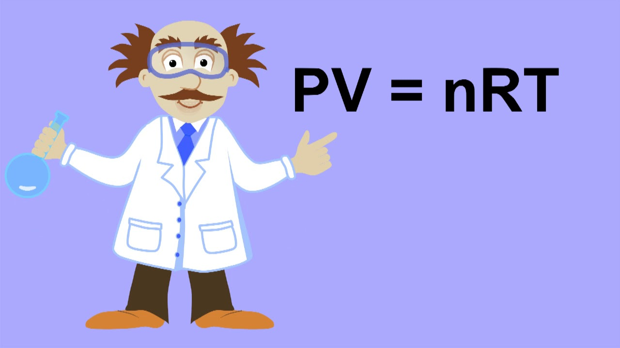

Rational Choice Assumptions
Systematic & Structured Problem-Solving
PREDICTABLE
The player fully understands the decision problem by knowing—
All possible actions, $A$;
All possible outcomes, $X$;
Exactly how each action affects which outcome will materialize; and
His rational preferences (payoffs) over outcomes.
Ideal human being
$$A$$
No judgment
$$X$$
All-knowing
Rational preference relations
$$v\left(a\right)$$
Rational
Chooses action with maximum payoff
…has well-defined objectives

Slide 27
A Rational Player
A player facing a decision problem with a payoff function $v\left(∙\right)$ over actions is rational if he chooses an action $a∈A$ that maximizes his payoff. That is, $a^{∗}∈A$ is chosen if and only if $v\left(a^{∗}\right)≥v\left(a\right)$ for all $a∈A$.

